Slide 1
Gym workout monitoring method using webcam.
Nikola Tomažin 204454IV
Bruno Marović 204444IV

Slide 2


1. Idea
Gym workout monitoring method using a webcam
Capture user’s movements while doing an exercise
Analyze the correctness of an exercise performance
Display mistakes to the user interface

Slide 3
2. Subtasks
Detect the joints of the human body and generate a "skeleton"
Adapt the program to detect different exercises
Optimise the code so it could be run in real time

Slide 4
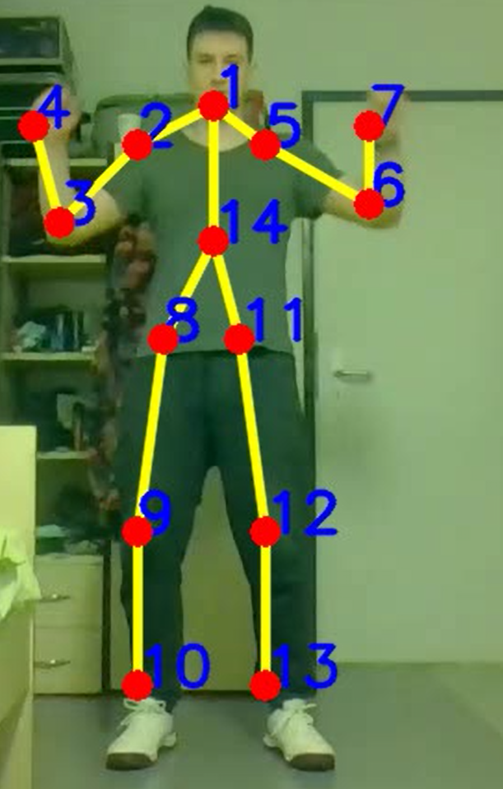
Joint and skeleton detection
MPII Human Pose Dataset
Neck – 1, Right Shoulder – 2, Right Elbow – 3, Right Wrist – 4, Left Shoulder – 5, Left Elbow – 6, Left Wrist – 7, Right Hip – 8, Right Knee – 9, Right Ankle – 10, Left Hip – 11, Left Knee – 12, Left Ankle – 13, Chest – 14.

Slide 5
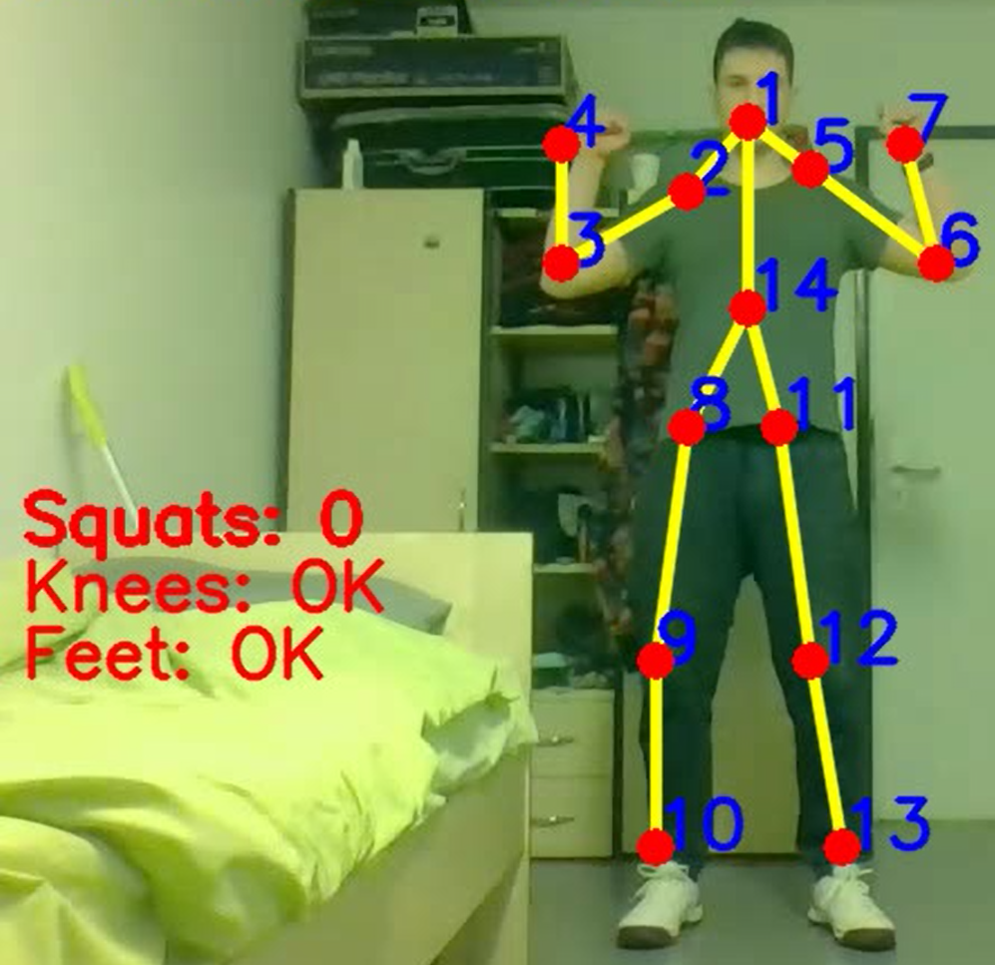
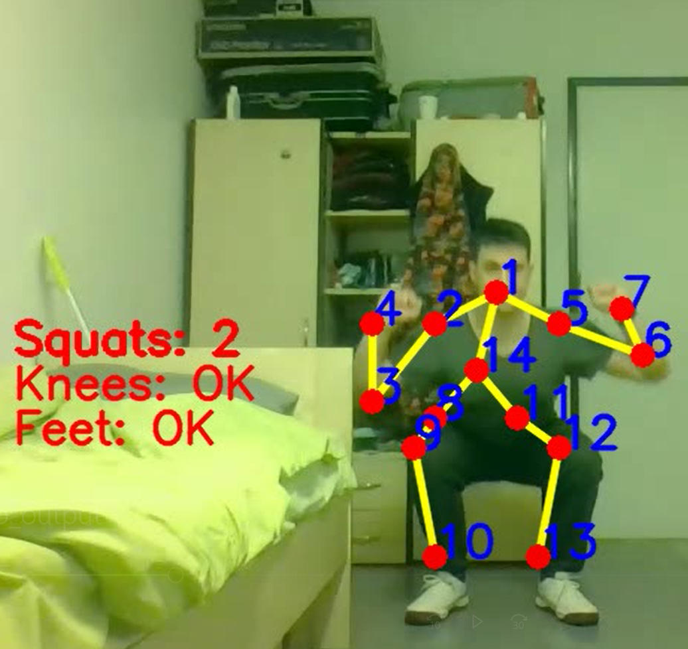
Detection of different exercises
Squatting Exercise
Monitoring:
user went low enough
knees aren’t close
feet are distant

Slide 6
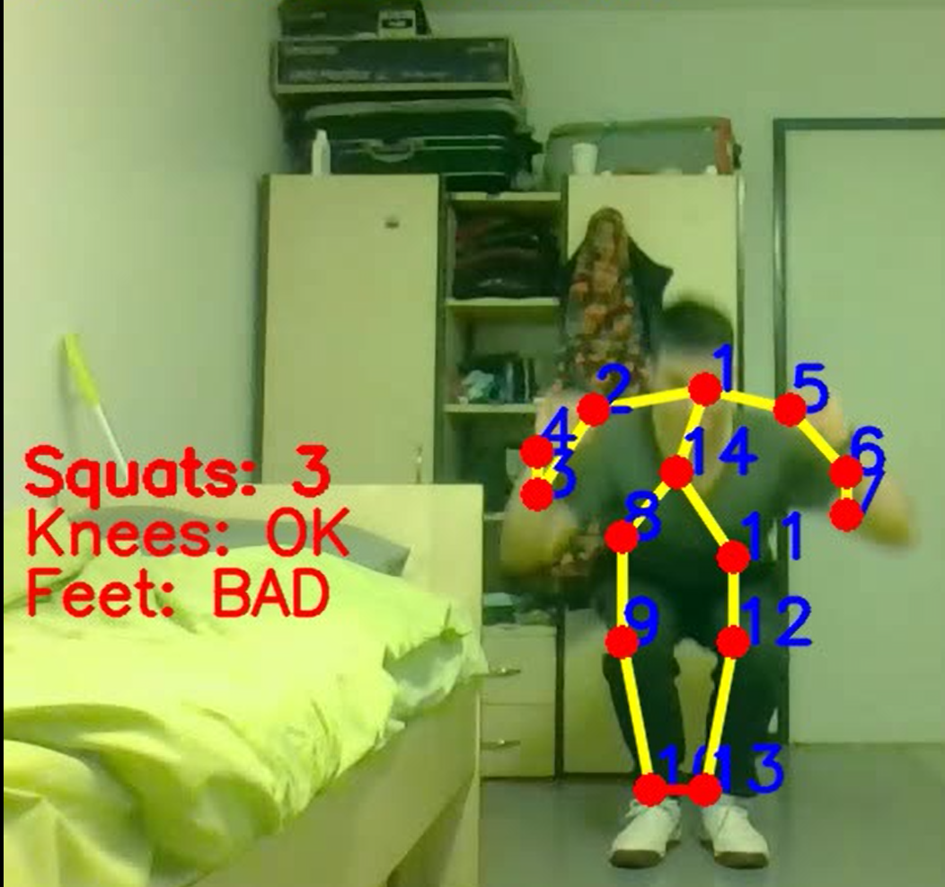
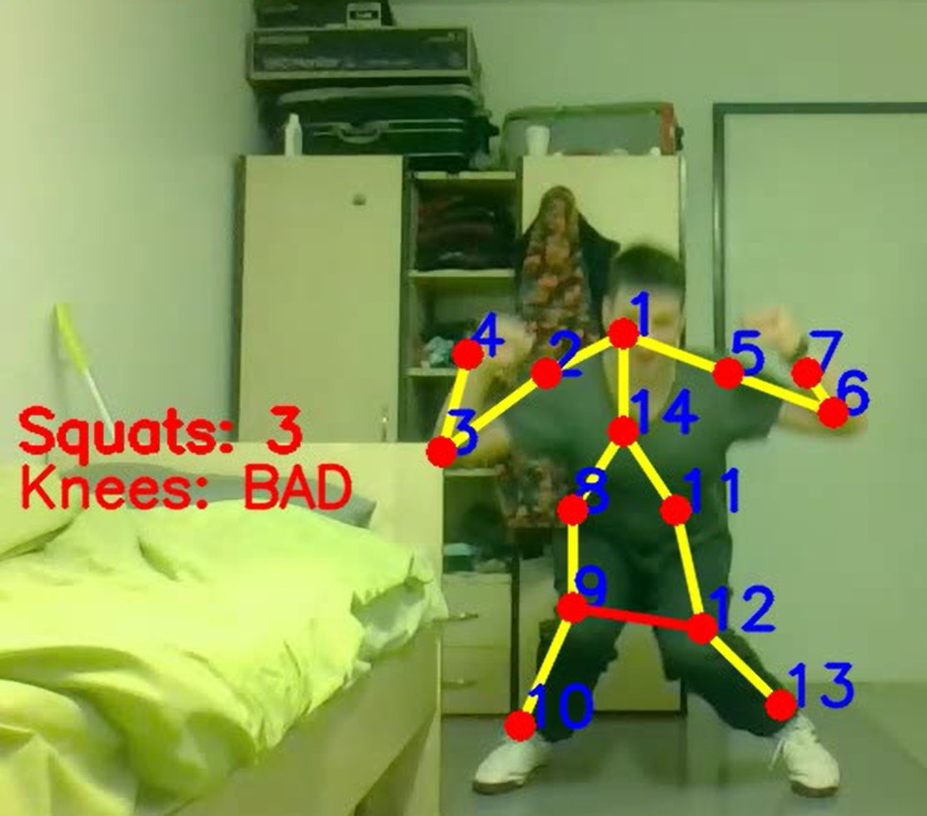

Slide 7
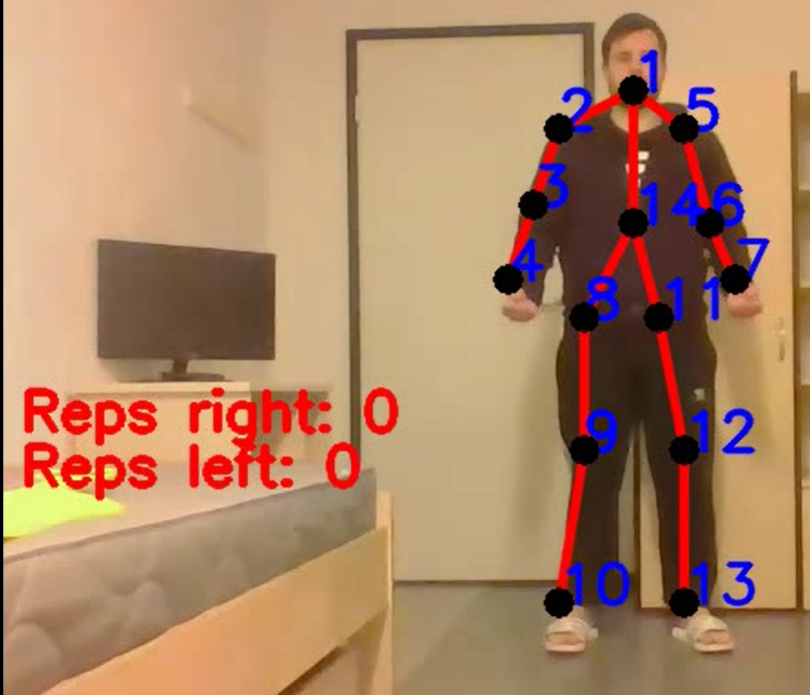
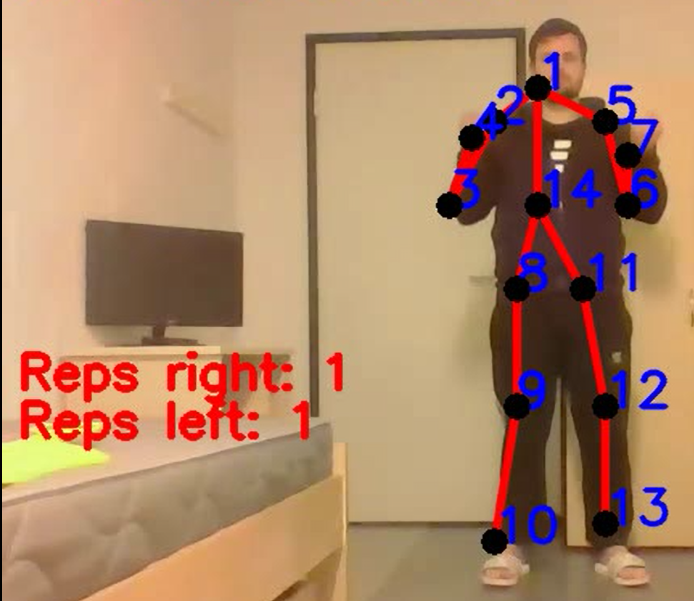
Detection of different exercises
Biceps Exercise
Monitoring:
each arm separately

Slide 8
3. Code optimization
GPU
Lower number of frames
Region of interest
Not able to do it in real-time
Workaround:
Taking a video then processing it
Asynchronous

Slide 9
4. Future work
More optimized model
More computational power
More exercises
Not able to do it in real-time
Workaround:
Taking a video then processing it
Asynchronous

